Slide 1
Chart your course
Kathleen Dollard
.NET Team Microsoft
Notes:
Suggestions for next time: * The cognitive search probably has a short shelf life before folks know this stuff
Add a split in AI between using AI – effectively using Copilot – and dev – prompt engineering
It’s not 1536 dimensions, but, vectors with 1536 values projected onto multiple 3D spaces – 512x512

Slide 2
Program Manager .NET Languages – C#, F# and VB
The world of tech just keeps moving faster!
How am I supposed to keep up?
Even the tools I’m familiar with keep changing; evolving.
Notes:
Do not start with yourself. Start with the abstract/empathy

Slide 3
The plan… Charting your course
A bit about me
Suggestions for TechBash
Skills vs knowledge
Depth of Knowledge
Example of general knowledge
Example of competency
Tips

Slide 4
First programmed in Jr. High
Hated computers
when mistakes were not free
Many languages,
many dialects
Fascinated about how people use computer languages

Slide 5
This week… Suggestions for learning at a conference
You will best remember what you talk to your peers about
Also, for some of you writing will help you remember
And, for some of you, experimentation with code will help
Gather resources and make time to review
Give a lunch and learn and keep notes of what you want to share
Alcohol affects the hippocampus
Involved in moving short term memory to long term memory
Notes:
Newton’s Third Law of Thermondynamics
5 minutes

Slide 6







Collaboration
Debugging
Profiling
Skills
IDE/tools
Communicating
Generally, learn by repetition
You sometimes do without thinking
Tend to have a long shelf life
Balance
Typing
Knowledge
Notes:
10 minutes

Slide 7
Depth of Knowledge (Webb or Bloomberg)
Creating
Expertise
Evaluating
Analyzing
Competency
Applying
Understanding
Background knowledge
Remembering
Notes:
VB6 Dan Appleman and Bruce McKinney

Slide 8
Expertise is not the goal for all things
Expertise
Competency
Background knowledge

Slide 9
Your organization is not well served if everyone has the same level of knowledge in all the things you use

Slide 10
How do we get there  and stay there ?
 Lots of varied experience
Increasing time per increment
Increased awareness of how much to learn
Expertise
 Study and experience
 Reasonable effort for new knowledge, Often with confidence
Competency
 Building and refining mental models
Reasonable effort for new knowledge
Overwhelmed
Background knowledge
Notes:
20 min mark

Slide 11
General knowledge
Key technique: Build and refine a mental model
Biggest challenge: Finding up to date and reliable resources
Best tip: Have several friends who can answer questions and confirm understanding

Slide 12

AI
Are you kidding? In an hour?
Example for general knowledge

Slide 13
A bit about cognitive search
Example for general knowledge
This is explicitly a simplified view

Slide 14
I am Kathleen Dollard, .NET Languages Program Manager
["I",
" am",
" Kath",
"leen",
" Doll",
"ard",
",",
" .",
"NET",
" Languages",
" Program",
" Manager",
"."]
"I" - Pronoun
"am" - Verb
"Kathleen" - Noun
"Dollard" - Noun
"," - Punctuation
".NET" - Noun
"Languages" - Noun
"Program" - Noun
"Manager" - Noun
"." (period): Punctuation
"I" - Pronoun
"am" - Verb be (Lemmatization)
"Kathleen Dollard" - Entity (NER/Named Entity Recognition)
"," - Punctuation
".NET" - Noun
"Languages" - Noun
"Program Manager" - Entity (NER/Named Entity Recognition)
"." (period): Punctuation
Tokenization
A visualization

Slide 15
"I" - Pronoun
"am" - Verb be (Lemmatization)
"Kathleen Dollard" - Entity (Named Entity Recognition/NER)
"," - Punctuation
".NET" - Noun
"Languages" - Noun
"Program Manager" - Entity (Named Entity Recognition/NER)
"." (period): Punctuation
Magic!
Stuff experts understand
[0.00164756608373814752,
-0.00647566083738147523,
0.00566083738147521647,
…
Total of 1536 values,
Which makes a very big vector
Embedding
Encoding into vectors

Slide 16
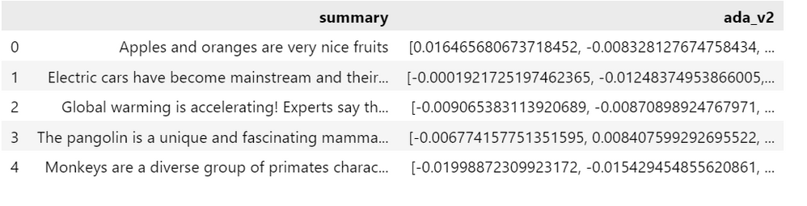
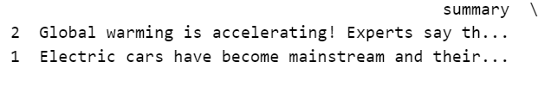
"I'm looking for information about climate change?"
Turn input into numbers
Compare vectors - example cosine similarity
Take the top two

Slide 17
Context is important
Short text does not lead to semantically good vectors
Chat cannot
Tell you what day it is?
Use past answers for future questions
Know relevant data
Prompt engineering adds context, samples, limits, etc.

Slide 18
Glossary
Large Language Models (LLM): Chat
Data frame: 2D table whose columns can contain many types of data
Tokenization: splitting text into small units to be processed
Hallucinations: model returns result that is not true
Embeddings: extracting features from raw data
Prompt/Prompt Engineering: preprocessing input and supplying context or samples to improve Chat results
Polyglot Notebooks: like Jupyter notebooks but supports many languages
Notes:
35 minutes

Slide 19
Competency lets you do your job effectively
You can still make mistakes, if they are caught. Analyzers!
Notes:
30 minutes

Slide 20
Competency
Key technique: Repetition, asking questions, code review
Biggest challenge: Finding enough time to expand knowledge
Best tip: Don’t be afraid to ask questions

Slide 21
Pattern matching
Example for competency
Notes:
45 minutes

Slide 22
Expertise
Key technique: Approach problems from many directions, creativity is key
Biggest challenge: Finding good feedback and discussion and increasing investment/learning ratio
Best tip: Articulating ideas and answering questions while teaching broadens your perspective

Slide 23
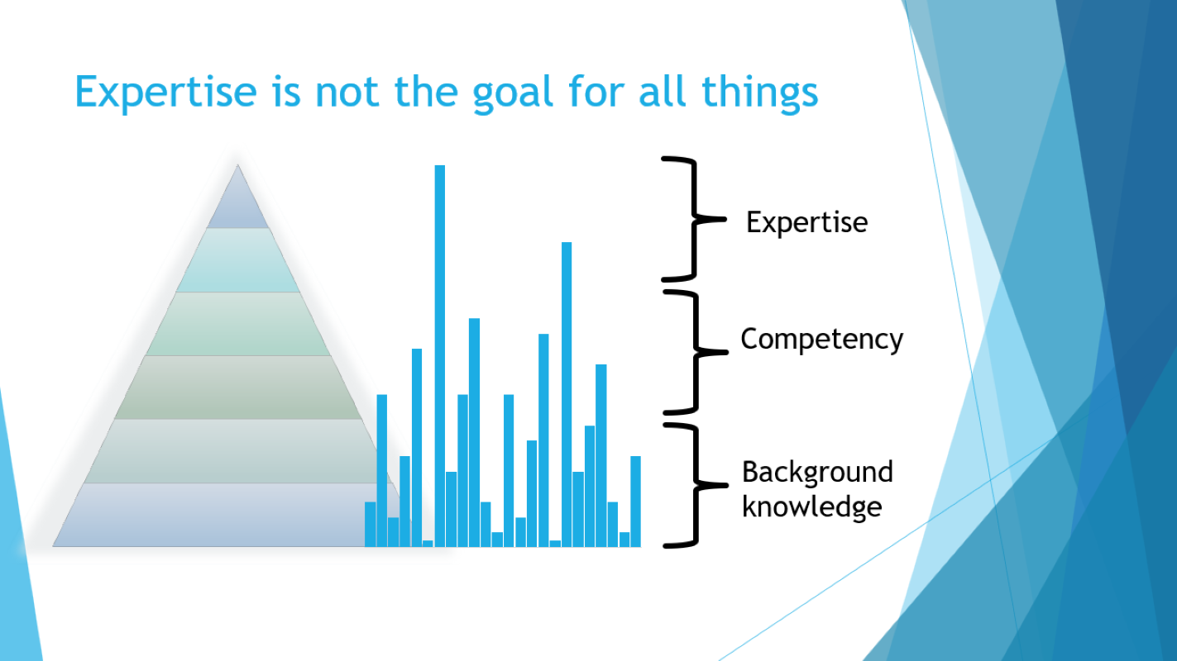
Consider where to have general knowledge, competency or
strive for expertise
Remember
You are not alone
Good resources are incredibly valuable

Slide 24

The most important resource here are those sitting next to you, and those you have lunch with

Slide 25






Slide 26

Thank you! Resources
Cognitive search/LLM/Chat
To understand NLP: From zero to - nearly - hero with Azure OpenAI NLP and vector-based search in Azure Cognitive Search - Microsoft Community Hub
An example aimed at coders: Demystifying Retrieval Augmented Generation with .NET - .NET Blog (microsoft.com)
.NET examples using Polyglot Notebooks: https://github.com/dotnet/interactive/tree/main/samples/notebooks/ai
Use `Getting started.ipynb` and watch .NET Blog (microsoft.com) for upcoming posts
Pattern matching
Tutorial: Build algorithms with pattern matching - C# | Microsoft Learn
Demo: KathleenDollard/sample-patterns at techbash-2023-start (and branch …-done)

